Slide 1

Notes:
Welcome you to Trinity Baptist - Second Part of the Seminar
Is the End of the World Coming…tonight we shall use a more
seminar like method rather than the Multi Media

Slide 2
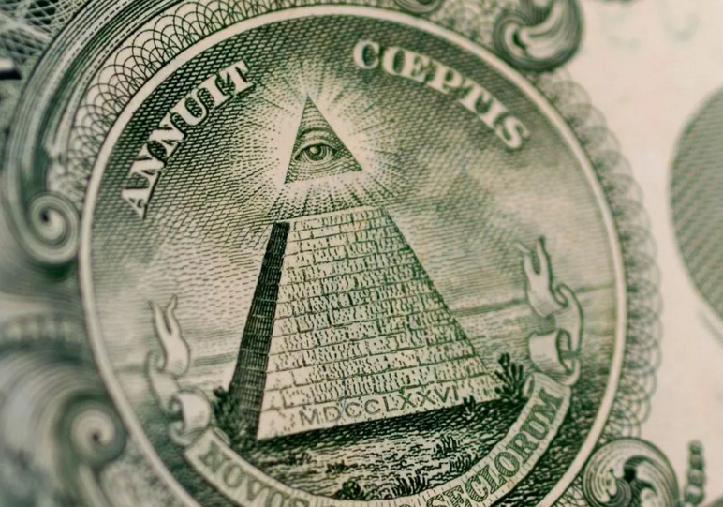
Do you ever wonder why these occult symbols and words are on our dollar?
Novus Ordo Seclorum
“New Order of the ages”
Notes:
Ever wonder why there are so many occult images on our dollar?
Novus Ordo Seclorum…the New Order of the Ages is its meaning.
Somehow the New World Order is connected to our dollar. Notice the
emphasis on the pyramid….this is Masonry and Masonry was
very much a part of most of our founder’s religion…we like to
think of them as being Christians (and they were) but they did
have a strong contribution from the occult through the Masons

Slide 3
Especially …..
THE ALL SEEING EYE!
(The Eye of Horus)
Notes:
Especially the all seeing eye…which is often the focus of the occult.
(click for the next slide)
Eventually tonight we will be calling this by the name the eye
of Horus after the Egyptian nomenclature , but this eye often
appears in occult literature ….even in the Lord of the Rings with Sauron’s red buring eye. The Egyptians believed the sun was an eye …

Slide 4
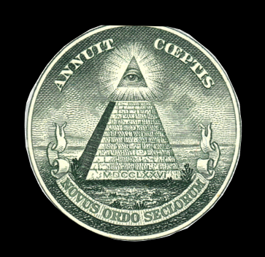
IS THIS JUST THE EYE OF GOD…as some try to tell you
The New World Order has been around
for many years and it has been growing
stronger.
Notes:
Black…click again.. Is this eye on the dollar just the eye of God as
many encyclopedias will attempt to inform you?
No indeed it is the occult all seeing eye the eye of horus and
part of the NWO. (Goes through animation goes black)

Slide 5

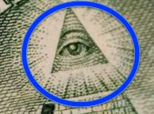
In fact; what we are experiencing in America, has a much deeper significance than even the election of evil people to office, even of the theft of the office of president.
It is nothing less than the long planned end game of the New World Order and the entrance of the Man of Sin, the sinister man the Bible calls the AntiChrist, John the Apostle calls the Beast, and the man Daniel the Prophet called the
“Little Horn” with an eye that boasts!
Notes:
circle appears …click again
Blurb appears (Read what appears)
Automated to …read again what appears. (Eye is automated)

Slide 6

According to the Bible, the story of human evil begins long ago in the Garden
Perhaps you think the story of Adam and Eve is a delightful myth but not to be believed as history.
Notes:
Click …goes black…click again and get the Adam and Eve slide read the slide.
The biggest mistake liberal people make about the Bible is to not read
it from a literal perspective…they call us fundamentalists
because we read and believe the Bible as being literally what it
says it is.

Slide 7
Allow me to dissuade you of your preconceived notions. You probably didn’t know that there is genetic based science to back up Adam and Eve.
Notes:
Words leave….click again the read the new words.

Slide 8
Paul, who wrote much of the Bible, under the power of the Holy Spirit, reveals 8 mysteries the Bible explains.. Tonight we deal with the last …the 8th Mystery of the Bible.
1. The Mystery of Israel (Chosen Servant)
2. The Mystery of His Will
3. The Mystery of Faith
4. The Mystery of the Kingdom
5. The Mystery of the Church
6. The Mystery of Godliness
7. The Mystery of Christ
Notes:
Black…click again and blurb about the Mysteries comes up.
Click to bring up the automation of the mysteries.
A mystery in the Bible is not like a mystery novel in English…in the minds of the Bible writers, especially Paul, the HolySpirit through the writer was revealing things hidden…thus…and restate each one.

Slide 9
And the 8th is: The Mystery of Iniquity…how evil, which originated in the Garden, has worked in the history of the human race.
Notes:
Black….click again…
The eigth mystery is in focus tonight…..the Mystery of Inquity which is
very similar in meaning to what secularists often call the New
World Order…only it goes much deeper into truth.

Slide 10
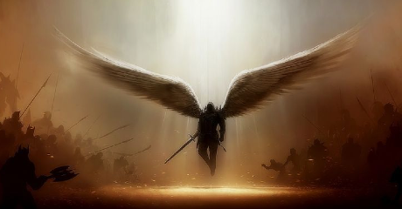
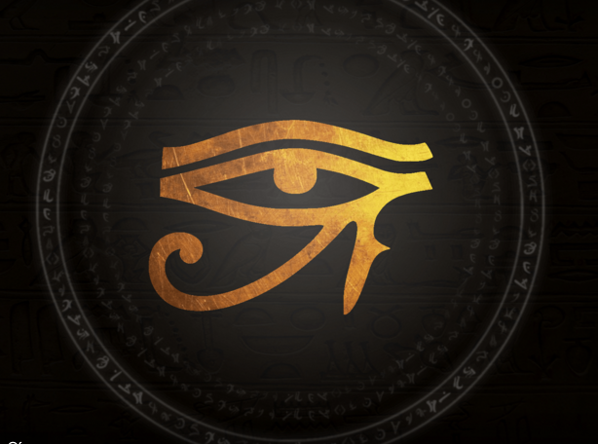

This Egyptian figure is the artistic way that the Egyptians portrayed the All Seeing Eye of Horus.
Rev. 12 tells us that there was a war in Heaven, and Satan was banished to earth with 1/3rd of the angels
Notes:
Black….click again….
The eye of Horus comes up (read it as it plays out)
Then automated ….satan appears as angel and read his part

Slide 11
“How you have fallen from heaven, O Star of the morning”
The Eye of Horus is the Eye of the lead Fallen Angel!

Slide 12
“How you have fallen from heaven, O Star of the morning”
“You have been cut down to earth.
You who weakened the nations!
But you said in your heart, I will ascend to heaven;
I will raise my throne above the stars of God,
And I will sit on the mount of assembly…
I will ascend above the heights of the clouds;
I will make myself like the Most High.” Isaiah 14
These are the words of Satan
the fallen star.

Slide 13
“How you have fallen from heaven, O Star of the morning”
“Nevertheless you will be thrust down to Sheol,
To the recesses of the pit.
Those who see you will gaze at you.
They will ponder over you, saying,
Is this the man who made the earth tremble,
Who shook kingdoms, Who made the world like a
wilderness…who did not allow his prisoners to go home?” Isaiah 14

Slide 14

Satan (once known as Lucifer – the bearer of light) had been what was called the “covering cherub” of the throne of God.
“You had the seal of perfection, Full of wisdom and perfect in beauty. You were in Eden, the garden of God; Isaiah 28
He was the serpent in the Garden

Slide 15
“You had the seal of perfection, Full of wisdom and perfect in beauty. You were in Eden, the garden of God;
Every precious stone was your covering…
On the day you were created…You were the anointed cherub who covers,

Slide 16
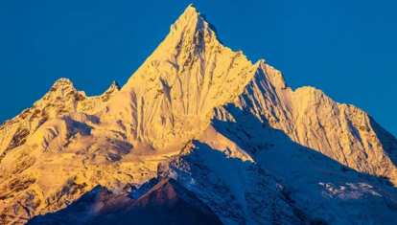
And I placed you there
You were on the holy mountain of God;
You walked in the midst of the stones of fire.
You were blameless in your ways…
Until unrighteousness was found in you…
You were internally filled with violence, And you sinned. Therefore I have cast you as profane From the mountain of God…And I have destroyed you…” Ezekiel 28

Slide 17
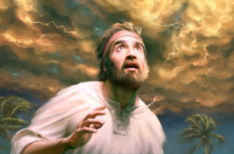
The prophet Ezekiel saw a series of visions of God seated on his throne supported by four beings of incredible power and glory. (the Cherubim)

Slide 18
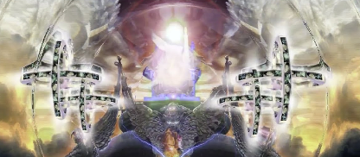
What he saw was outside of the ability of human art to depict…nevertheless they try.

Slide 19
Could Lucifer have covered the throne from above…perhaps that is what “covering” means?
His number is always 5.
What he saw was outside of the ability of human art to depict…nevertheless they try.
These four “wheels” are artist depictions of Cherubim, beings of great power around the throne of God.
Could Satan have been the fifth?

Slide 20
This is pure speculation …but Satan is often represented by a five pointed star…he is called “the fallen star.” In fact Angels are often called “stars” and the occult often features the “pentagram” the five pointed star, or five sided figure like our “Pentagon,” the place where we prepare for war.

Slide 21
Most often Satan is an inverted star …the five points may have something to do with his being the fifth and fallen cherub, but we don’t know any of this for sure…but it is interesting that almost every nation in the world uses the five pointed star on their national flag.

Slide 22
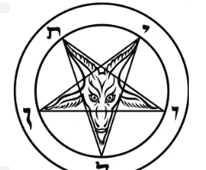

Slide 23
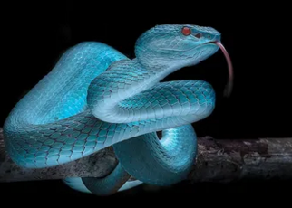
We don’t know for certain, how Satan was “the covering Cherub,” but we do know that he was in the garden in time to deceive Eve, and cause Adam to choose to sin.

Slide 24
Satan is often described as a serpent; and reptiles are cold blooded killers. He was the snake in the Garden of Eden.

Slide 25
And he offered Eve a series of enticements leading her toward thinking she was God. This is always the way of a being who himself wanted to raise his throne above the throne of God.

Slide 26
“Now the serpent was more crafty than any beast of the field…And he said to the woman, “…has God said, ‘You shall not eat from any tree of the garden?’
And the woman said...’From the fruit of the trees of the garden we may eat; but from the fruit of the tree which is in the middle of the garden, God has said, ‘You shall not eat from it or touch it, lest you die.’
And the serpent said to the woman, ‘You surely shall not die! For God knows that in the day you eat from it your eyes will be opened, and you will be like God, knowing good and evil.” Genesis 3

Slide 27
To become just like God in total control of your own life and destiny…this is the objective of Satan and every self deluded fallen creature…this is the Mystery of Iniquity. (Gen. 3:16 “...Yet your desire shall be for your husband, [even though] He shall rule over you...”) Satan would always have a unique bondage over the woman, even though there would be conflict between “her seed” and the Serpent’s seed, never the less, she would always seek or “desire” to overthrow the rule of her husband.

Slide 28
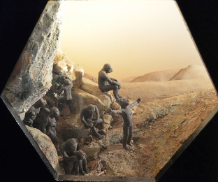
According to evolution man evolved from some apelike creature about four million years ago.

Slide 29
But if man had been on the earth that long there would be about 150 billion people on earth, about half the mass of the earth itself!
So at present populations, it is not likely that mankind, in any form, has been on earth more than 6000 years.

Slide 30
This is science falsely so called.

Slide 31

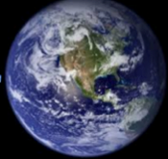

6000 years fits the evidence …it is also about how long the Bible says man has been on earth
And there is plenty of scientific data to back this up!
Like the rates of mutations (mistakes) found in each generation of DNA ….DNA is the code of life found in each cell.
Adam to the present is about 200 generations, in the 6000 years of Bible history.

Slide 32
200 gen. x 60 errors/ gen. = abt 12,000 errors
So after 200 generations at the expected rate of mutations, we ought to find about 12,000 genetic errors in the current DNA of human populations. So what do we find?
And most of these are minor changes – non lethal to the organism, but obviously changes in the basic DNA codes. They are retained in the genetic code and reproduced over and over again.

Slide 33
So…how many do we actually find?
About 12,000 variations from normal, just as predicted, this would take about 6000 years. This is solid genetic evidence for a real single couple existing about 6000 years ago….Adam and Eve!
By comparison, (4 million years of evolution) would produce over 7 million mutations …probably a lethal gene load. It is not likely that human life could survive for 120,000 generations with such a gene load!

Slide 34
Thus we provide strong evidence that Mankind has been on the earth about 200 generations from the fall in the garden, and...
The fall is real because Adam and Eve were real .

Slide 35
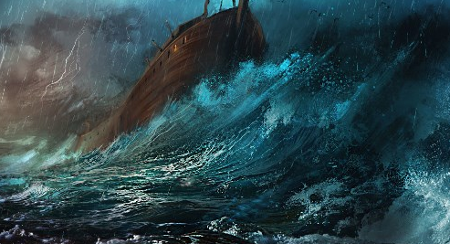
This puts Creation, about 4000 BC
About 2000 years before Christ – 6000 years total time .
Noah’s Flood….about 2500 BC
After the fall….mankind got progressively worse and worse…by Genesis 6 …God lamented that He had created Man.

Slide 36
And God decided to destroy all flesh on the earth…and by this time human flesh had even become mingled with “strange” flesh, men were mating sinfully with fallen angels.

Slide 37
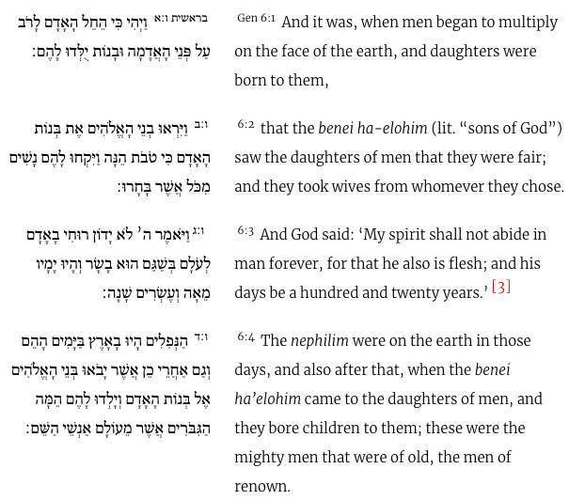
Genesis 6:1-3

Slide 38
“the Benei- elohim” – “the angels who fell” they took human wives and they produced giants or the heroes of old {Heracles and Perseus}
Half man and half angel…they were the “Fallen Ones” ….the Greeks called them Heros…but they were very dangerous and often cannibals.
And I know…by this time you are saying whoa, how on earth could this happen?

Slide 39
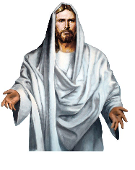
“…Jesus answered (the Sadduces)
and said to them, “You are mistaken, not understanding the Scriptures, or the power of God. For in the ressurrection they neither marry, nor are given in marriage, but are like the angels in heaven.”
And this has caused many debates in the Church…Angels cannot reproduce…it is said.
But notice that Jesus did not say they “cannot” reproduce, but that they don’t marry. Angels probably don’t need to eat either, but when they have visited men on earth, they have eaten, as with Abraham.

Slide 40
The early church uniformly believed that some angels violated God’s prohibition and were cast into a deep part of Hell called Tartarus.

Slide 41
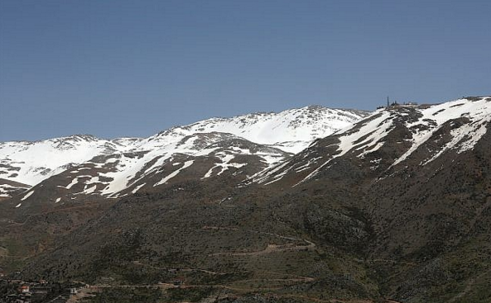
“Now it came about, when men began to multiply on the face of the land, and daughters were born to them, that the “sons of God” (the “bene elohim” / fallen angels) saw that the daughters of men were beautiful; and they took wives for themselves, whomever they chose.” Genesis 6
This is Mt Hermon in Syria….In the ancient Semitic language Hermon, “hrn” means something taboo or very evil.

Slide 42
“Now it came about, when men began to multiply on the face of the land, and daughters were born to them, that the “sons of God” (the “bene elohim” / fallen angels) saw that the daughters of men were beautiful; and they took wives for themselves, whomever they chose.” Genesis 6
It is the tradition in the Holy Land that the fallen angels came down to earth as the “watchers” and it happened on Mt. Hermon.

Slide 43
“And angels who did not keep their own domain, but abandoned their proper abode, He has kept in eternal bonds under darkness for the judgment of the great day. Just as Sodom and Gomorrah…in the same way as these indulged in gross immorality and went after strange flesh” Jude 6,7

Slide 44

The Apocryphal Book of Enoch, a very old Hebrew scroll, but never actually considered Scripture says:
“And it came to pass when the children of men had multiplied, that in those days were born unto them beautiful and comely daughters. And the Angels…saw and lusted after them, and said to one another: ‘Come, let us choose us wives from among the children of men and beget us children. And Semjaza, who was their leader, said unto them “I fear you will not agree to this deed, and I alone shall have to pay the penalty of a great sin…(they all swore allegiance to one another)

Slide 45
“And all the others together with them took…wives, and each chose for himself one, and they began to go in unto them and to defile themselves with them,…
And they became pregnant , and they bare great giants.
And when men could no longer sustain them, the giants turned against them and devoured mankind. And they began to sin against (all living things) and began to devour one another’s flesh, and drink the blood. Then the earth laid accusation against the lawless ones.”
The Nephilim - The Six Fingered Giants of Old

Slide 46
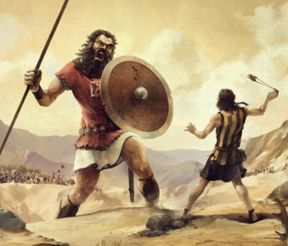
Angelic genes mixed with men to produce giants, and this was the tripwire to the Flood
“

Slide 47
Later in the Bible narrative, we find out that Goliath, who fought David, was also a` Nephilim. This was long after the Flood so not all Nephilim genes were eliminated in the Flood.
“

Slide 48
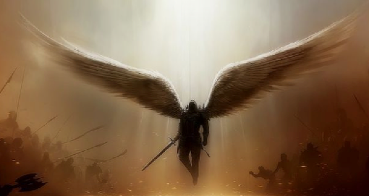
“
Whether the Enoch account is true or not, the Bible certainly implies that some angels left their Heavenly abode, and produced the Giants….the mystery of Iniquity begins to unfold with the fall of Satan, his angels and the fall of man.

Slide 49
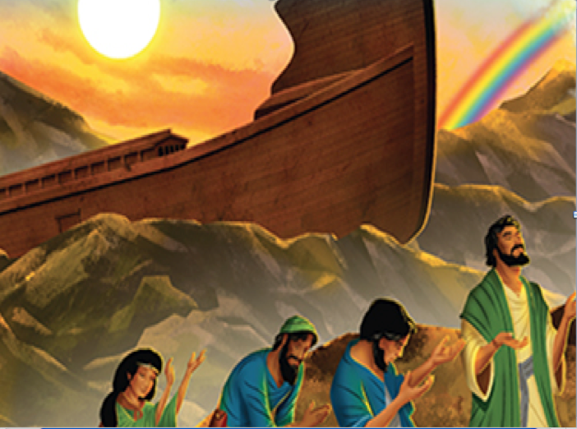
“
But instead of wiping out all life, God found a man to save the world. “Noah found grace in the eyes of the Lord.” Gen. 6:8

Slide 50
“
The earth was completely covered in water and only Noah, his three sons, and their wives survived. God put an arc in the sky as a
promise never to inundate the world again.

Slide 51
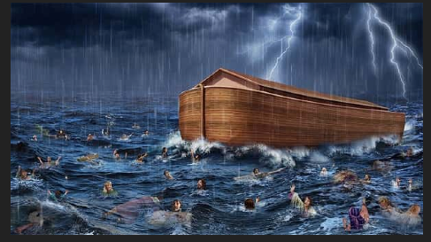
“
Perhaps you don’t believe in Noah’s worldwide flood?

Slide 52
“
Over 200 civilizations from all parts of the world remember that God once flooded the world. Eight people survived in a boat which saved the animals.

Slide 53
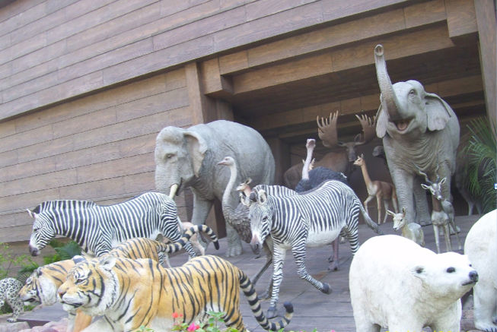
“
A new day began on the earth…God told man to populate the earth, but
A new day began on the earth as Noah released the animals to go where they might. Likewise, He commanded men to go forth and populate the earth. But they refused, and gathered in the land of Shinar to build a tower to reach to heaven and to God Himself. Gen. 9:7

Slide 54
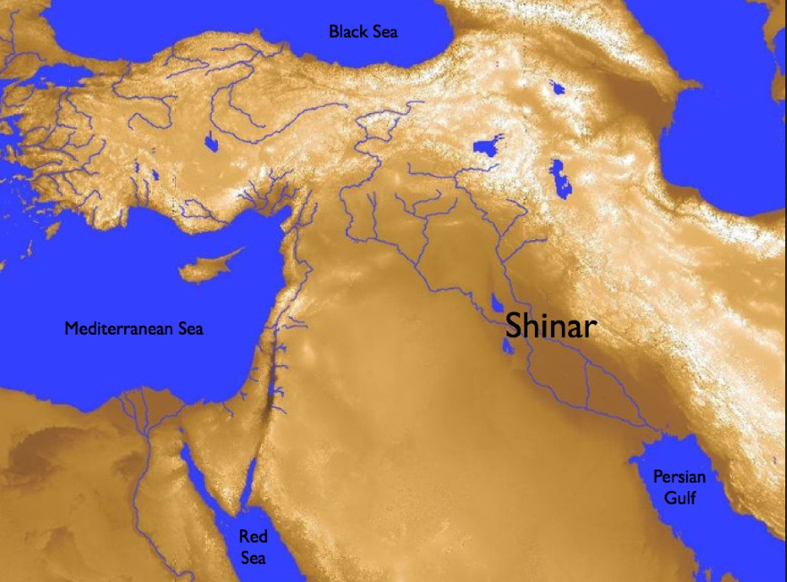
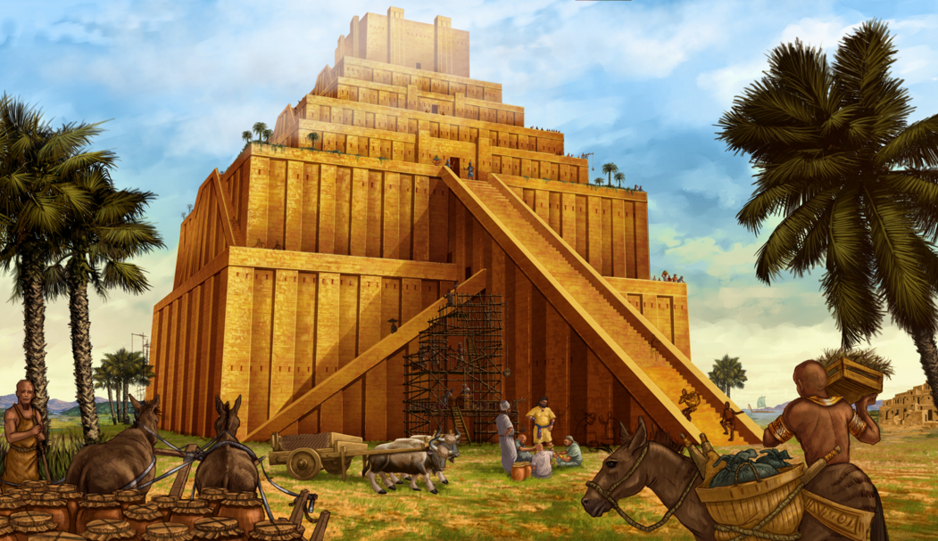
“
Mountains of Ararat where
the Ark landed
Men were now in opposition to God and they wanted to stay together
To build a tower to reach into heaven. Babylon
A new day began on the earth…God told man to populate the earth, but

Slide 55
And if God wouldn’t let him in he would force
the door.
Man was still trying to be like the Most High
“
Mountains of Ararat
Men were now in opposition to God and they wanted to stay together
To build a tower to reach into heaven. Babylon
A new day began on the earth…God told man to populate the earth, but

Slide 56
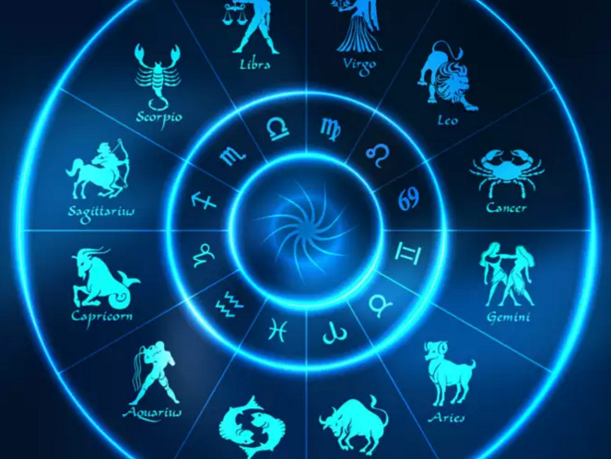
From ancient Mystery Babylon, near the Tower of Babel came the incantations and occult practices, like astrology, which had leaked through the Flood. They probably came with the wife of Ham. So at least one of the wives had genes from the evil giants. Somehow even the tainted genes made it through the flood..
“
The people began to follow after “Doctrines of Demons,” and continued to believe the serpent’s lie that you can be “gods.”
Satan, “prince of the power of the air,” has always believed that he is a god, and wants the earth for himself.
A new day began on the earth…God told man to populate the earth, but

Slide 57
“Now the whole earth used the same language and the same words. And it came about as they journeyed…that they found a plain in the land of Shinar and settled there.
And they said to one another, ‘Come let us make bricks…And they used brick for stone, and they used tar for mortar…Come let us build for ourselves a city, and a tower whose top will reach into heaven, and let us make for ourselves a name; lest we be scattered abroad over the face of the whole earth.
“
And the Lord came down to see the city and the tower which the sons of men had built. And the Lord said, ‘Behold, they are one people, and they all have the same language. And this is what they began to do, and now nothing which they purpose to do will be impossible for them.
A new day began on the earth…God told man to populate the earth, but

Slide 58
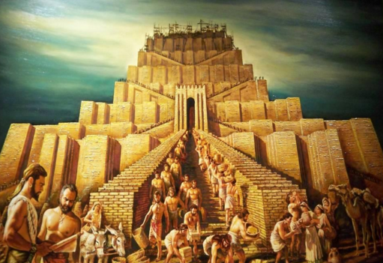
“Come let Us go down and there confuse their language, that they may not understand one another’s speech.
So the Lord scattered them abroad over the face of the whole earth.” Genesis 11
“
A new day began on the earth…God told man to populate the earth, but

Slide 59
The Mystery of Iniquity spread over the earth, but wherever men went there are strange similarities …pyramids of various types appear everywhere. The Zodiac of the stars are very similar. Even in as far flung places as the Americas and China. So many things in varied societies so similar and all from the darkness.
The people of Noah’s son Ham went primarily to Egypt and much of the Middle East, and perhaps into the Orient.
“
The people of Japheth spread into the northern tier latitudes and became the tribes of the north.
The people of Shem became the Shemites (Semites) and eventually Israel.
A new day began on the earth…God told man to populate the earth, but

Slide 60
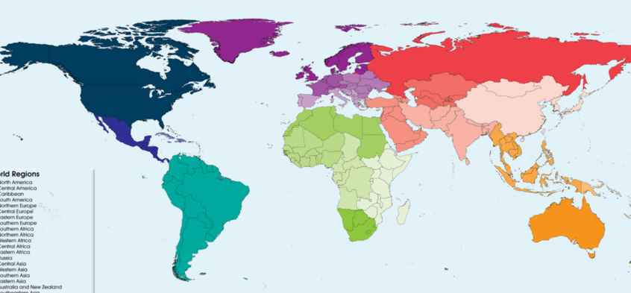
Japeth
Shem
“
Ham
A new day began on the earth…God told man to populate the earth, but
After the Tower - the Sons of Noah and their families spread out over the surface of the earth. They gathered according to their speech.

Slide 61
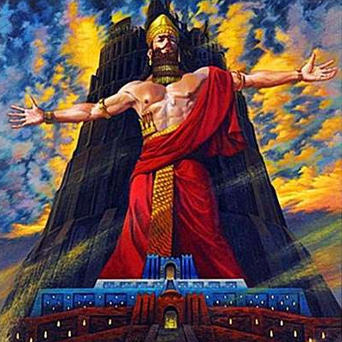
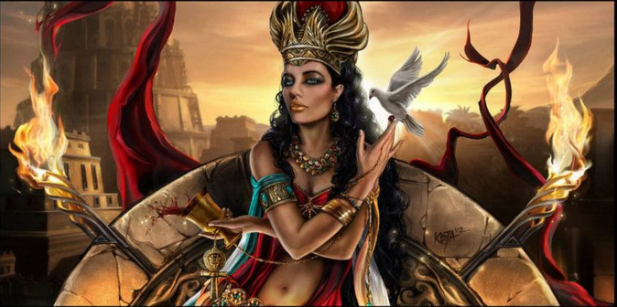
And his evil queen, Semiramas who is the mother of Tammuz…and in this Spirit of Iniquity they are pictured together- the so called Holy Family
One man stands out in the building of the Tower that would reach to God. Nimrod, who is called the mighty hunter, the son of Cush, son of Ham, in whom the Nephilim continued.
“Now Cush became the father of Nimrod; he became a mighty one on the earth…And the beginning of his kingdom was Babel…in the land of Shinar. Gen. 10
Nimrod builder of the Tower against God
A new day began on the earth…God told man to populate the earth, but

Slide 62
Mystery Babylon spread, from the confusion of tongues at the Tower throughout the world. And so it continues to this present hour. In the Egyptian version, Horus is the “god man” child of the “goddess” Isis, his mother. Wherever it went the Mother/Child cult of Semiramus produced a “god baby” This mother child “holy family,” as they are often called, exists in every part of the world today. Don’t be confused by the language…they are anything but “holy.”
“
A new day began on the earth…God told man to populate the earth, but

Slide 63


Just the old lies of Semiramus and Babylon back again.
“
A new day began on the earth…God told man to populate the earth, but
The New Age Movement pioneered by Madam Blavatsky
began to infiltrate into western society…Theosophy, Spiritism, Rosicrucianism, Trancendental Meditation etc.

Slide 64
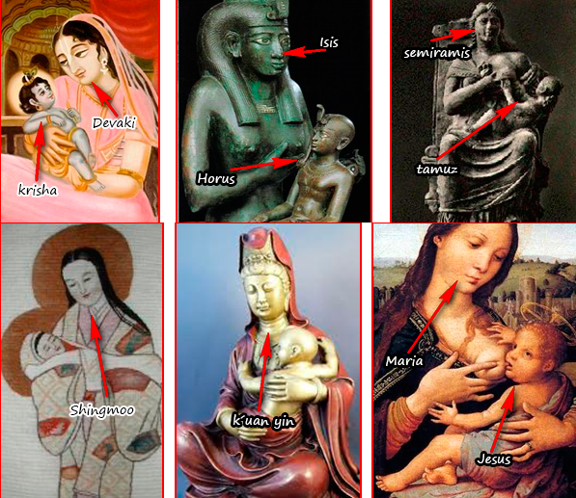
To Egypt
From Babylon
To India
“
Satan trying to confuse the truth.
To Europe and Catholic confusion.
To Ceylon and China the far east
A new day began on the earth…God told man to populate the earth, but

Slide 65
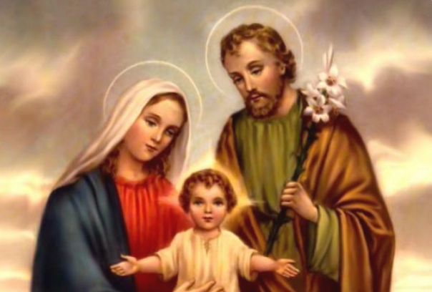
But Jesus always remains a child in the Mother Child cult and the Mother (Semiramus)
is the focus.
“
To Catholics under the “deep things of Satan”
Rev. chapter 2
Mary becomes the
co-redemptrix
“Queen of Heaven”
with Christ. And
He stays a baby.
This is not to add condemnation to
celebrating Christmas.
A new day began on the earth…God told man to populate the earth, but

Slide 66
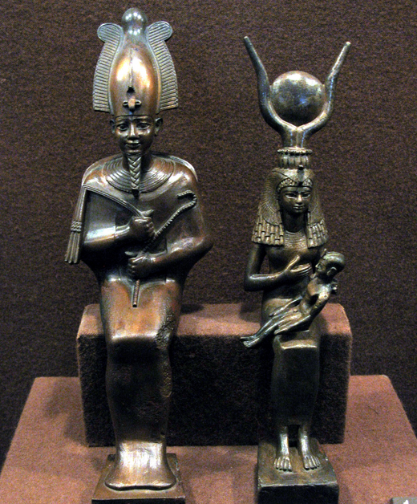
Small idols of the Mother – Child cult from ancient Egypt.
“
Notice that Isis (Semiramus) has the child on her lap. He is called Horus in Egypt. Over her head is the great Eye of Horus, same as on our dollar bill.
A new day began on the earth…God told man to populate the earth, but
Notes:
Key: Black again and then the Egyptian appears. Automation.

Slide 67
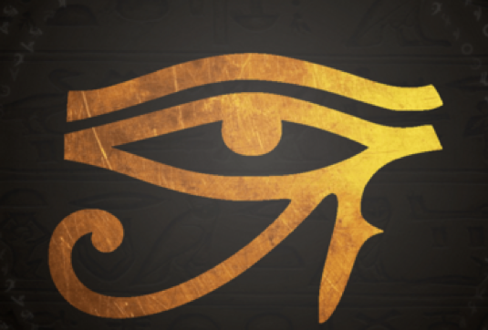
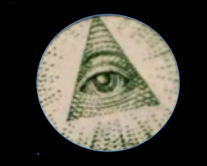
“
The All Seeing Eye of Horus….
Notes:
Key: Click again for the automation.

Slide 68
In the last days men will be rebuilding the Tower that Nimrod built.
“
Mystery Babylon
Notes:
Key: The screen blackens…click and the tower appears again wth mystery Babylon starting to come back again. It is not that the tower itself will be rebuilt, though I suppose such could happen…but that the ideas of the ancient Nimrod and Semiramus and Tammuz the Child (called Horus in Egypt) will come back together in the Anti-Christ.

Slide 69
Not that a literal tower will rise but
A New World Order to bring in the
true Eye of Horus (AntiChrist)
“
Mystery Babylon
Notes:
Key: The tower appears….with Mystery Babylon on the front…not a literal tower but rather an explanation of what is happening.

Slide 70
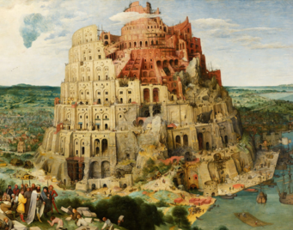
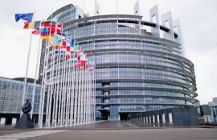
The unfinished Tower of Babel by Peter Brueghel in 1563
Babylon coming back together. The EU building in Brussels is made to echo the ancient painting.
“
The “babel” (confusion) of tongues, which God began at the original tower is being patched back together against God, in the UN, and the EU, and NATO…Satan’s One World Order.
Notes:
Key: The black again and with the click automation of the painting by Brueghel and the copy of the modern in the EU building.

Slide 71
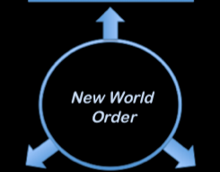
“
Notes:
Key: The symbol of the NOW appears.

Slide 72
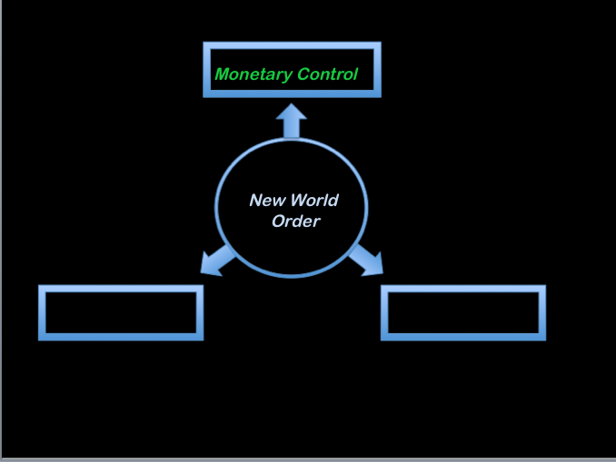
“
Notes:
Key….the monetary arm of the NWO

Slide 73

One of the major ways in which the NWO will gain control over your life is through money….perhaps this is why the All Seeing Eye has been on our dollar. But Cash is too fluid…you cannot control cash.
“
Satan’s end game is always control
Destroy the world’s economy Create dependency - Pandemic
Cultivate Fear
666 Mark of the Beast
Notes:
Key: The monetary arm finished out in greater detail…automation after the click.
Since cash is too free and cannot be easily traced, the NWO will try to remove the use of cash..this is happening now. Eventually the loss of credit and debit cards will be touted and a mark on the person for purposes of security of finances will be first encouraged and then demanded. When demanded this Mark will include a promise to follow the world system…this will be the Mark of the Beast.

Slide 74
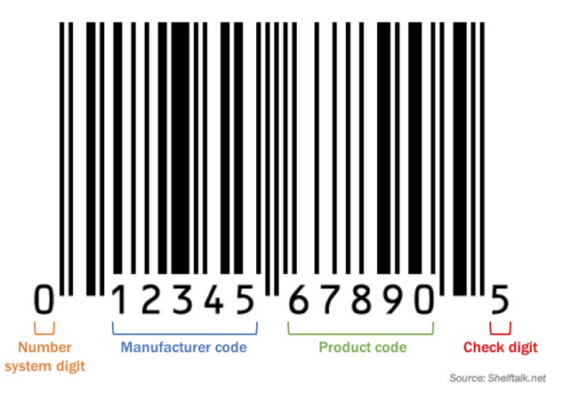
The UPC Product Codes all have had the 666 ` embedded in them for years.
“
Note that the lines above 6 are the same diameter as those above bars on the un-numbered center and ends.
Notes:
Key: a blue box appears…when clicked the UPC will appear and the automated pictures will follow.

Slide 75
“
6
6
6
The 666 is hidden in every UPC bar code on every product sold in the USA.
Notes:
Key: The UPC remains and will automate to form the 666.

Slide 76
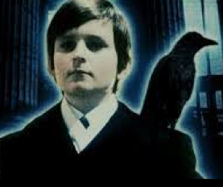
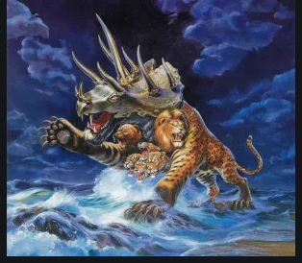
“And I saw a beast coming up out of the sea,…And I saw one of his heads as it it had been slain, and his fatal wound was healed. And the whole earth was amazed and followed after the beast; …and they worshipped the beast, saying,…who is able to wage war with him? …And there was given to him a mouth speaking arrogant words and blasphemies; …And he opened his mouth in blasphemies against God, to blaspheme His Name… Revelation 13
“
The New Nimrod?
He may look like this on the outside.
But he must be a monster on the inside. Revelation 13
Notes:
Key: The automation will begin at the click of the new slide. When clicked again a monster appears. Read Rev. 13.

Slide 77
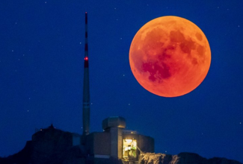
Lying Wonders Coming Upon the World
“For the mystery of iniquity is already at work; only he who now restrains will do so until he is taken out of the way. And then that lawless one will be reveled whom the Lord will slay with the breath of His mouth and bring to an end by the appearance of His coming;
“
that is, the one whose coming is in accord with the activity of Satan, with all power and signs and false wonders, and with all the deception of wickedness for those who perish, because they did not receive the love of the truth so as to be saved.” 2 These. 2:7-10
Anti-Christ
“And there will be signs in sun and moon and stars, and upon the earth dismay among nations, in perplexity at the roaring of the sea and the waves , men fainting from fear and the expectation of the things which are coming upon the world; for the powers of the heavens will be shaken.” Luke 21:25
Notes:
Key: The word Anti-Christ appears on the screen…with the click appear the words Read them.

Slide 78
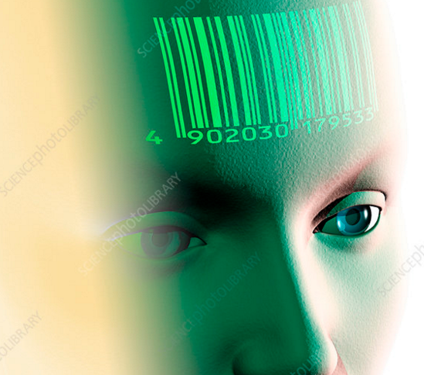
And he causes all, the small and the great, and the rich and the poor, and the free men and the slaves, to be given a mark on their right hand, or on their forehead,
“
Notes:
Key: Blank and on the click the marked person will appear. Click and the 666 appears.

Slide 79
And he causes all, the small and the great, and the rich and the poor, and the free men and the slaves, to be given a mark on their right hand, or on their forehead,
“
6
6
6
and he provides that no one should be able to buy or to sell, except to one who has the mark, either the name of the beast or the number of his name….his number is six hundred and sixty-six.” Revelation 13
Notes:
Key: The marked man now adds words at the click.

Slide 80


Monetary Control
“
New World Order
Political Control
Religious Control
Notes:
Key: The second arm of the NWO appears….at the click it fills in.

Slide 81
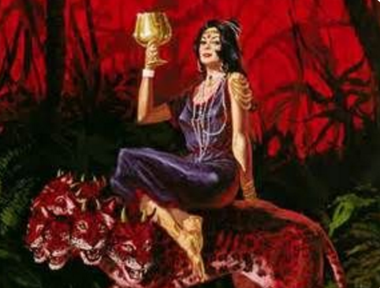

“
“And he carried me away in the Spirit into a wilderness; and I saw a woman sitting on a scarlet beast, full of blasphemous names…And the woman was clothed in purple…and adorned with gold and precious stones…having in her hand a gold cup full of abominations and of the unclean things of her immorality… Rev 17
Notes:
Key: Blank at first but the Woman Riding the Beast appears at the click. Automation now includes the verse beginning.

Slide 82
“
and upon her forehead a name was written, Mystery Babylon
…, THE MOTHER OF HARLOTS AND OF THE ABOMINATIONS OF THE EARTH. And I saw the woman drunk with the blood of the saints, and with the blood of the witnesses of Jesus Revelation 17
Notes:
Key: Automation takes over on the click and the rest of the verse.

Slide 83
“
There are actually three woman in the Bible …this Harlot, the woman with her feet on the moon and her face in the sun. And the Bride of Christ married to Christ at the marriage supper of the Lamb.
Notes:
Key: The woman remains and on the click comes the final thoughts.
the three women of the book of Revelation…each of them represents and group of people, each of them has a purpose to fulfill.

Slide 84
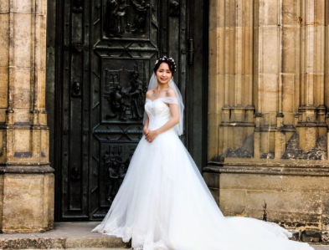
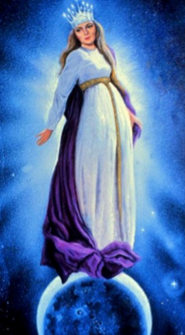
“
The Harlot
The Bride
The Rev. 12 Woman
Notes:
Key: The three women appear at the click each of the three has an important role to play as things wrap up in the NWO.

Slide 85
“
The Harlot
The Bride
The Harlot represents a people unfaithful to Christ. They have joined the Mystery of Iniquity to persecute and behead believers during the last of the last days.
The Rev. 12 Woman
Notes:
Key: The same three are there as the slide changes…Click and the Harlot church is explained.
Note that this is not just Catholicism, though the Pope becomes the head…it is the rejoining of all Christianity back into a single entity by the ecumenical movement. This Pope is trying to rejoin all those with a Christian motif back into one world religion. Get all the good guys together.

Slide 86
“
The Harlot
The Bride
The Bride represents a people who have trusted Christ as their Savior. More about this to come !
The Rev. 12 Woman
Notes:
Key: The harlot part is removed and at the click the bride steps forward.

Slide 87
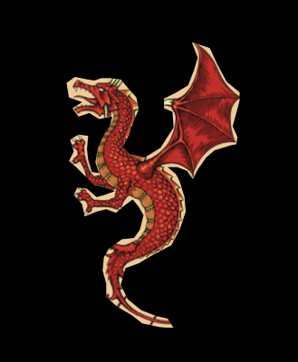
“
The Harlot
The Bride
The Woman with moon at her feet and the stars in her hair is Israel. (Remember Joseph’s dream ?) She is pregnant with Jesus and the Devil awaits His birth to kill him. Rev. 12
The Rev. 12 Woman
Notes:
Key: at the click the bride is removed, and at the final click the rev 12 woman appears to the fore.
While she appears in Rev. 12, the imagery is supposed to remind us of Joseph…the sun and the moon and the 12 stars are Jacob and his wives and the 12 tribes..this woman represent Israel and she will be called upon to stay upon the earth while the anti-christ rules …but she will run to the wilderness for 3 ½ years to protect her until the Messiah returns with the Church.

Slide 88
Today we focus on this woman. She is Mystery Babylon the mother of Harlots.
“
The Woman who rides the Beast
Notes:
Key…the harlot apears again…and at the click words above her head.
The ecumenical movement will take over all religion in the world even Islam will finally have some sort of connection to her….this is an echo of the Tower and How all men wanted to join together in a religious effort to reach heaven. She will be riding the AntiChrist…the beast, and think she has control of Him…and he will hate her and eventually destroy her.

Slide 89
“
This “Woman” is a Harlot because she is supposed to be married to Christ and yet she entertains her “lovers” of all religions and along with the New World Order she is deep into the occult. She thinks she can ride the Beast, the AntiChrist. (But eventually he destroys her)
Notes:
Key: Words appear on the click. Read the words.

Slide 90
“
She represents false religion and she sits on the Seven Hills. She is Rome. She invites all religions into a worldwide religious amalgam.
Notes:
Key: The words appear at the click.

Slide 91
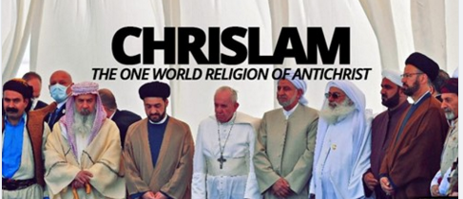
“
.
Notes:
Key: The words appear at the click.

Slide 92
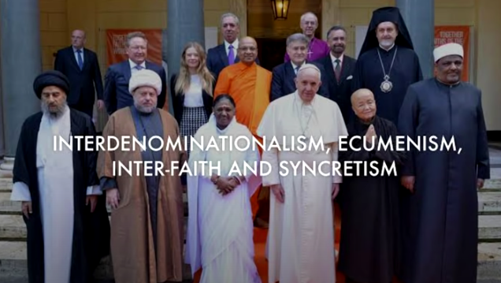
“
On the altar at St Peters there is a Koran, there is Native American sweet grass, there is a Budha, there is are amulets from paganism, there are idols of Hinduism….ecumenism is not just Christians anymore.
.
Notes:
Key: The words appear at the click.

Slide 93
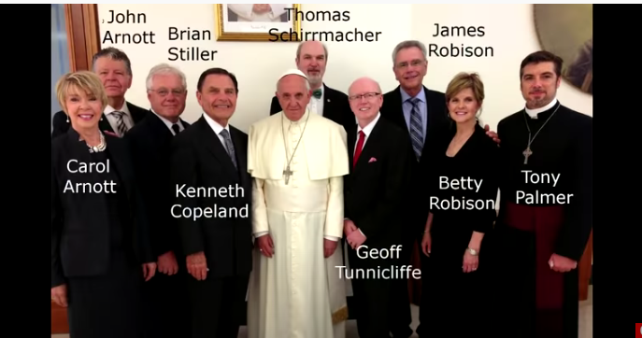
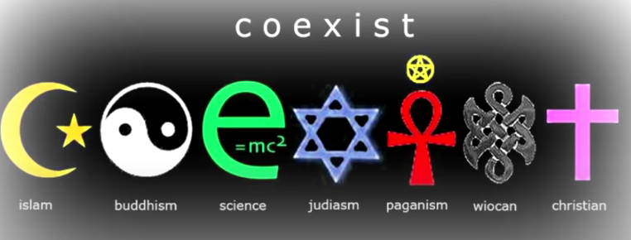
“
The high powered TV evangelists are all on board
.
Notes:
Key: The words appear at the click.

Slide 94

“
She ends up drunk with the blood of the true believers getting saved upon the earth. AntiChrist gives her responsibility to deliver the Mark of the Beast (Mark the People) and to kill those who will not conform.
Notes:
Key: the words appear with the click

Slide 95

“
Lying Wonders…..In 1917 during WWI three children in Fatima Portugal experienced a visitation (Catholics call it an apparition) by a being calling herself the Virgin Mary.
Notes:
Key: Screen goes black and with the click appears the three witnesses of the apparition. automation takes over …read the slide.

Slide 96
“
Lucia Santos
Francisco
Marto
Lucinta Marto
At Fatima, Portugal, (named after Mohammed’s daughter), this “Mary” apparition, told the children to do things that are directly against the Bible…. these are Doctrines of Demons.
Notes:
Key: Names appear on the children…and with the click appear the words.

Slide 97

“
Lucia Santos
While the children had a direct experience with the “Lady” as they call her, thousands in the town and around the region saw amazing signs in the sun. It “danced” in the sky and began to emit shafts of rotating colored light, and finally looked like it was coming down, crashing onto the earth.
Notes:
Key: The screen goes black and with the click appears those who saw the apparition of the sun dancing in the sky.

Slide 98

“
Lucia Santos
Her message was to “make reparations” and “do penance” to keep people out of Hell. God would destroy the world if the thorns ever pierced her immaculate heart.
Notes:
Key: the Lady with the stars appears on the screen…click and the words appear.

Slide 99
“
Lucia Santos
Mary was honored to be the mother of Jesus but she needs a Savior just like anyone else.
She is not the Queen of Heaven…that is the Mother Son cult of Babylon all over again. She cannot save anyone.
Notes:
Key: Click for the words.

Slide 100

“
Lucia Santos
The message of Fatima flies in the face of the message of the Bible which tells us to receive the grace of God by asking Christ to forgive us and come into our hearts. Penance and Reparations are attempting to go to heaven through works.
Notes:
Key: Pic of the empty tomb appears….and with the click the words.

Slide 101
“
Lucia Santos
Fatima is a lying wonder. It is error and deception. Satan makes his fake religion look as close to the real as he can. But the fake saves no-one.
Notes:
Key: the empty tomb again and the words with the click

Slide 102
“
Lucia Santos
Francisco
Marto
Lucinta Marto
Just as Dorothy wanted to know who the man behind the curtain was….one day Francisco looked behind the Apparition Tree and saw there a demon that nearly scared him witless.
Notes:
Key: the children of the apparition again….and the words when clicked

Slide 103

Roman Catholics have made a new movie of this whole episode and are hoping to bring it to the modern world.
“
Notes:
Key: the screen goes blank and at the click we see the ad for FATIMA

Slide 104

“
And here then is the apparition of Mary as a movie special effect.
As shown here it is still very
seductive in its power to
influence. Such is the lie.
Notes:
Key: the screen goes blank and at the click comes the pic of the apparition.

Slide 105

70,000 saw this! Even ships at sea…people were on the ground begging for their lives!
“
The sun began to “dance” in the sky, and people could look at the orb without apparent damage to their eyes…then the sun began to spin and a pinwheel of colors flowed out in all directions…then the sun appeared to grow menacing and raced downward toward them…
Notes:
Key: the blank again….this time at the click words fly in about Fatima and the sun takes over in automation.

Slide 106

“
So......what comes next?
This is only a prop from “The Day the Earth Stood Still”
But what if it seemed to be real?
Notes:
Key: appears What comes next? then at the click the flying saucer.

Slide 107
“
“And there will be signs in the sun and moon and stars, and upon the earth dismay among nations,…men fainting from fear and the expectation of the things which are coming upon the world…” Luke 21
Notes:
Key: automated words appear explaining this Day the Earth Stood Stil.

Slide 108
“
The demonic is well aware of the current culture of UFO’s, and aliens from other worlds. In fact, the demonic probably made these things up in the first place. More signs of the End of Days. But it will all be a lie, a lie to frighten the world.
Notes:
Key: the words vanish and at the click new words appear.

Slide 109

“
Notes:
Key: Now the final leg of the NWO appears on the screen.
Already the AntiChrist system is asserting control over all the earth through this so called pandemic. While there were probably reasons to worry about this virus it was not Ebola or Marsburg…or something similar…but the NWO got control of the world through this and now people are easy to manage ….through fear. I am afraid that political contol is already with us.

Slide 110

The third leg on this platform of deceit is Political Control, control that will eventually install the anti-Christ onto the throne of the world.
“
One World Government
Anti-Christ
Notes:
Key: A blue circle appears…at the click…the automation clicks in and directs to the coming AntiChrsit…the coming new Nimrod to rule over the world and direct us away from the truth.

Slide 111

Each summer in July there gathers near San Francisco the mighty men of the world, a group of great wealth and power …part of the conspiracy to make the world ready to receive Anti-Christ.
“
This is the story of the Bohemian Grove…
These men are here for a size comparison. The occult owl idol is immense in size.
Notes:
Key: This is the Bohemian Grove owl idol…. at the click… the words appear..Read..

Slide 112
the Bohemian Grove…
“
The most powerful men in the world doing Druid rites to an Owl god of fire
Notes:
Key: click to add the words.

Slide 113
It is almost beyond belief, but for the last 130 years the leaders of countries, banking, and media have been meeting in secret, at the Bohemian Grove, near San Francisco,
Grown men doing ancient Druid rites, often without clothing, and burning a child in effigy…they say.
(We can only hope the child is only an effigy!)
“
Notes:
Key: Again click to add the words.

Slide 114



Such a strange activity, though perverse and possibly criminal, would hardly warrant mention in such a program as this, if it did not entail the rich and powerful from all over the world.
These same powerful global elite meet in other globalist clubs and structures like the Bilderberg Group of Europe, the Counsel of Foreign Relations in America, and the Trilateralists of Europe, US and Japan.
“
Notes:
Key: To add the words click.

Slide 115
You may call it “conspiracy thinking” and try to dismiss it, and the controlled media will go right along with you on this.
These are the leaders of the world gathering in secret to worship an idol and plot the direction of nations.
“
Notes:
Key: Click for the words.

Slide 116
When men who control the destiny of nations, worship an enormous flaming idol of darkness, with the idea that children should be sacrifices, even in effigy…something is amiss. (Note: when somebody is pretending to sacrifice children, and is kept back only by the law…they really want to sacrifice children!)
“
Notes:
Key: Click for the words.

Slide 117


“
Notes:
Key: Political control appears…and at the click the words of the primary teacher of Bill Clinton, Carrol Quigley appear.

Slide 118

“
Notes:
Key: click to add words….

Slide 119

“
Notes:
Key: click for the words. Truman.

Slide 120

“
Notes:
Key: Teddy Rosevelt

Slide 121

“
Notes:
Key: Right up to the moment…one of the true movers and shakers of the modern world is Klaus Schwab

Slide 122

This is the actual glowing pattern that the Moderna vax leaves on your wrist….it is called “Luciferase”…and leaves a mark, a pattern on the skin that will fluoresce under black light….Mark of the Beast? NO BUT IT IS GETTING PEOPLE READY…
“
Notes:
Key: As to the vaccine…you and I need to be able to make our own decisions regarding our health and what is injected into our bodies. But the NWO is going to press for universal vaccination and it is just so that they can begin to control even what goes in and out of our bodies. Does anyone hear the Mark of the Beast in all of this?

Slide 123

“
Notes:
Key: Quigley again…..who authored a book on the Global Conspiracy happy to be called part of this.

Slide 124
666 -“The Mark”
“
CFR/Bilderberg
Bohemian Grovers
One World
Religion
“Woman Rides the Beast”
Notes:
Key: fill in the parts of the chart at the click.

Slide 125

Antiochus Epiphanes (Antiochus Image of God)
Think it can’t happen? The Abomination of Desolation already happened one time before.
AntiChrist will seat himself on the altar in the Holy of Holies showing the world he is God…this is the Abomination that Daniel spoke of.
“
Set up an image of Zeus and slaughtered a pig in the Jewish Temple in Jerusalem…
Notes:
Key: the Abomination of Desolation in the new Jewish Temple.

Slide 126
AntiChrist is the White Horseman of the Four Horsemen of the
Apocalypse.
“
Notes:
Key: Blank and then AntiChrist as the white horseman of Revelation 6

Slide 127

“
Death
Famine
War
AntiChrist
AntiChrist is coming to rule the world…and to worship him by taking his mark, is to spend eternity in the flame of Hell. These four demonic judgments storm around the earth.
Notes:
Key….the four horsemen.

Slide 128


666
“
666
AntiChrist may look like Jesus or the devil himself, we do not yet know…but regardless, he will be the incarnation of the evil one himself.
Notes:
Key: One or the other.

Slide 129

“See to it that no one misleads you. For many will come in My name saying, I am the Christ and will mislead many.
“
“For false Christs and false prophets will arise and will show great signs and wonders, so as to mislead, if possible even the elect (the choice servants of Christ) …If therefore they say to you, ‘Behold He is in the wilderness, do not go forth, or ‘Behold, He is in the inner rooms,’ to not believe them. For just as the lightening comes from the east and flashes to the west , so shall the coming of the Son of Man be…” Mat 24: 4, 24,25
Notes:
Key: This is the Son of Man….who gave Himself on a cross for your redemption.

Slide 130
“
Last night we talked about the Rapture …the lifeboat available to all those who know Jesus as their personal Savior.
Notes:
Key: This is the Son of Man….who gave Himself on a cross for your redemption.

Slide 131
The Rapture will remove all true Christians from the earth before the Tribulation, when all these terrors of the New World Order / The Mystery of Iniquity come to pass…and they are coming very very fast.
“
SO HOW DO YOU BECOME A “REAL” CHRISTIAN?
1. God loves you and offers a wonderful plan for your life.
“I came that they might have life, and have it more abundantly.” 1 John 10:10
Notes:
Key: This is the Son of Man….who gave Himself on a cross for your redemption.

Slide 132
“
So why aren’t more people experiencing the abundant life?
Notes:
Key: This is the Son of Man….who gave Himself on a cross for your redemption.

Slide 133
2. Man is sinful and separated from God.
“All have sinned and fallen short of the glory of God.” Romans 3:23
“
Holy God
Man is always trying to reach up to God through good works etc.
Sinful Man
But none seem to reach up high enough.
Notes:
Key: This is the Son of Man….who gave Himself on a cross for your redemption.

Slide 134
3 Jesus Christ is God’s only provision for man’s sin.
“God demonstrates His own love toward us, in that while we were yet sinners, Christ died for us.” Rom. 5:8
“
Holy God
Here God through the cross has reached down to man
Sinful Man
Notes:
Key: This is the Son of Man….who gave Himself on a cross for your redemption.

Slide 135
4. We must individually receive Jesus Christ as Savior, then we can know and experience God’s love and plan for our lives.
“As many as received Him, to them He gave the right to become children of God, even to those who believe in His Name.” John 1:12
“
Holy God
We receive Christ through personal invitation.
Sinful Man
Notes:
Key: This is the Son of Man….who gave Himself on a cross for your redemption.

Slide 136

Christ Speaking:
“Behold I stand at the door and knock;
if anyone hears My voice and opens the door, I will come into him.” Rev. 3:20
“
Notes:
Key: This is the Son of Man….who gave Himself on a cross for your redemption.

